Slide 1
Python Module 1
Introduction to Python
Data Analytics

Slide 2
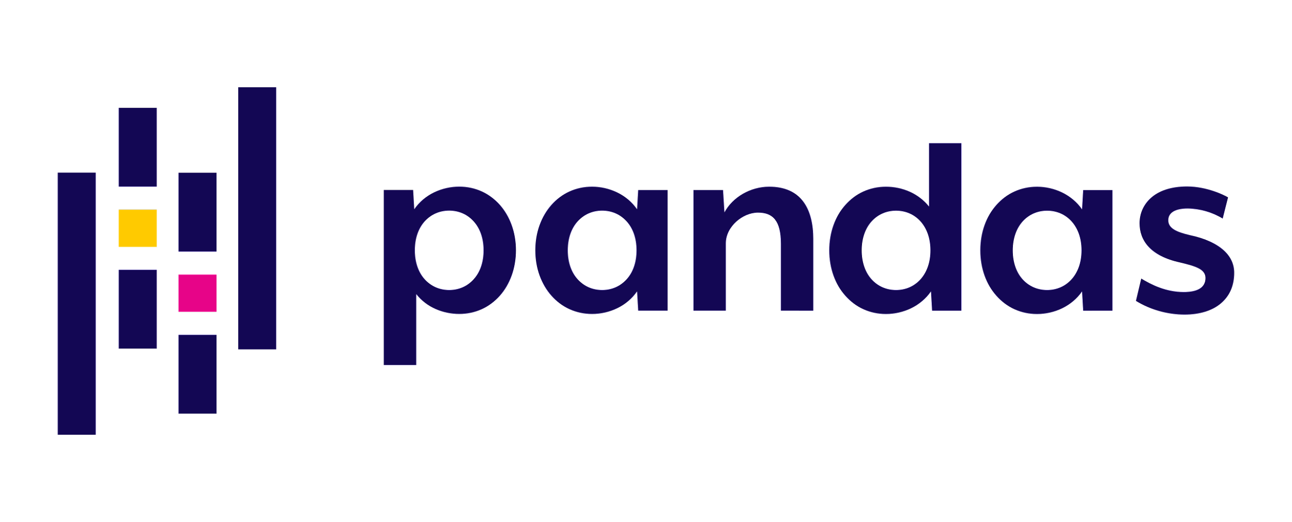


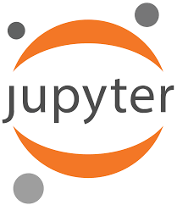



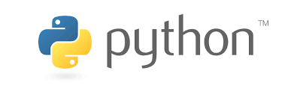



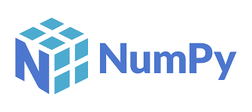


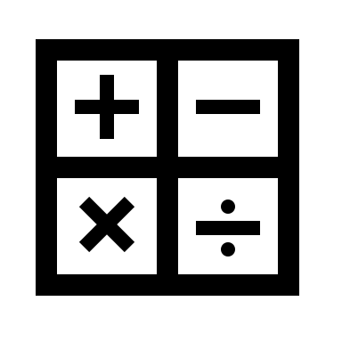



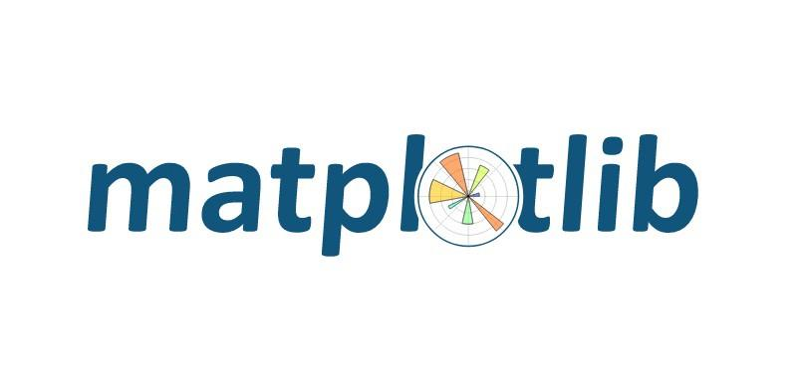







Anaconda
Jupyter
Data Types
Flow control
Classes
Containers
Machine Learning
Data Science

Slide 3
Viz
Analysis
File handling
Data structures
Data types
Kernel
IDE or Notebook

Slide 4





Integrated
Development
Environment
Kernel
Machine code
Processor
Analyst

Slide 5

OK, But what is Python?
Python is a popular high-level programming language that is widely used in a variety of fields, including web development, scientific computing, data analysis, artificial intelligence, and machine learning.
It was first released in 1991 by Guido van Rossum and has since then become one of the most widely used programming languages in the world.
Named for Monty Python’s Flying Circus, the greatest TV show ever
Latest version* is Python 3.11

Slide 6
Python Features
Some of the key features of Python include:
Simple syntax: Python uses a simple, intuitive syntax that makes it easy to learn and read. This makes it an ideal language for beginners.
Interpreted language: Python is an interpreted language, which means that the code is executed line by line, rather than being compiled beforehand.
Extensive libraries: Python has a vast collection of libraries that allow you to perform a wide variety of tasks without having to write a lot of code from scratch.
Cross-platform: Python code can be run on a variety of platforms, including Windows, macOS, and Linux.
Object-oriented: Python is an object-oriented language, which means that it uses classes and objects to represent data and functionality.

Slide 7
Python Integrated Development Environments
Some of the most popular Python IDEs include:
PyCharm: A popular IDE for Python development, which is available in both a free and a paid version. It is developed by JetBrains.
IDLE: An IDE that is bundled with Python itself, and is therefore available for free. You get what you pay for.
Sublime Text: A popular text editor that can be used for Python development, and has a wide range of plugins and packages available.
Spyder: An open-source IDE designed specifically for scientific computing and data analysis with Python.
Jupyter Notebook: An interactive web-based IDE that allows you to write and run Python code in a browser, and is widely used for data analysis and scientific computing.
Jupyter Lab: Like Jupyter Notebook, but better

Slide 8

What’s Does Object Oriented Mean?
An ‘object’ has attributes and methods.
A dog has attributes:
breed
weight
color
and methods
walk()
feed()
squirrel!()

Slide 9
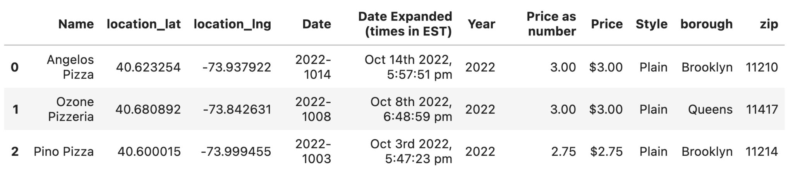
What Do Objects Have to do with Data?
pizza = pd.DataFrame()
Columns
Attributes
Rows
pizza.append()
pizza.dropna()
pizza.describe()
Methods

Slide 10
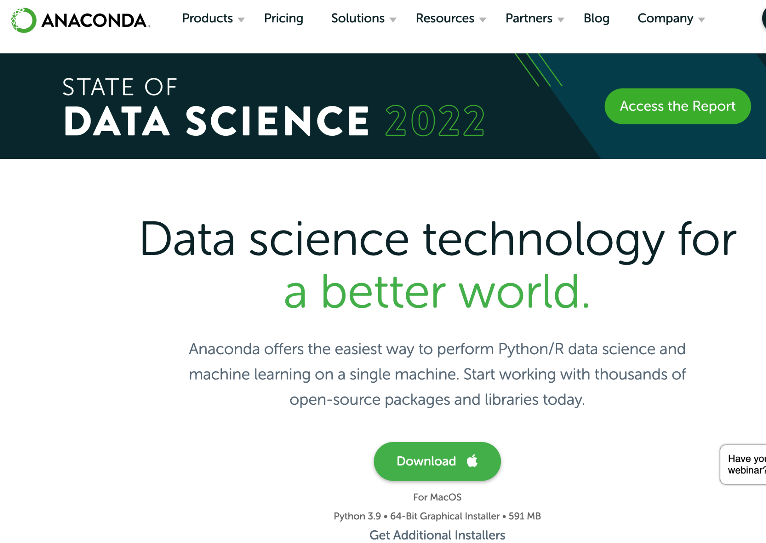
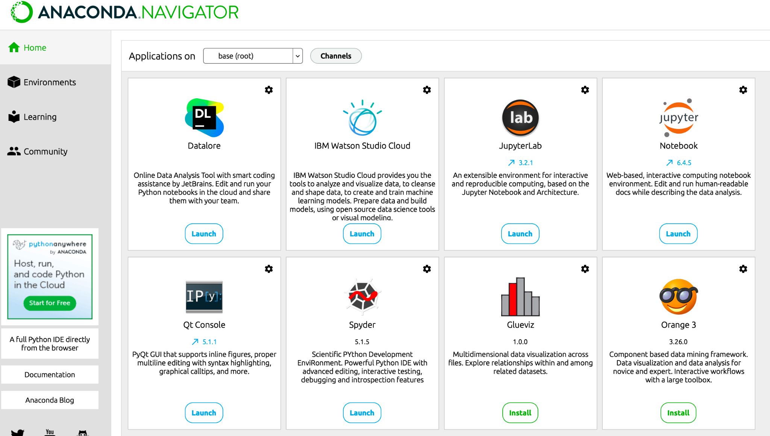
Install Anaconda

Slide 11
Jupyter Lab and Jupyter Notebook
Both run in your browser
Both save files with .ipynb extension
Both connect to a Python interpreter (installed by Anaconda)

Slide 12
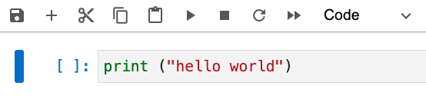
Jupyter
Save
Add cell
Cut cell
Copy
Paste
Run
Stop
Code cell

Slide 13
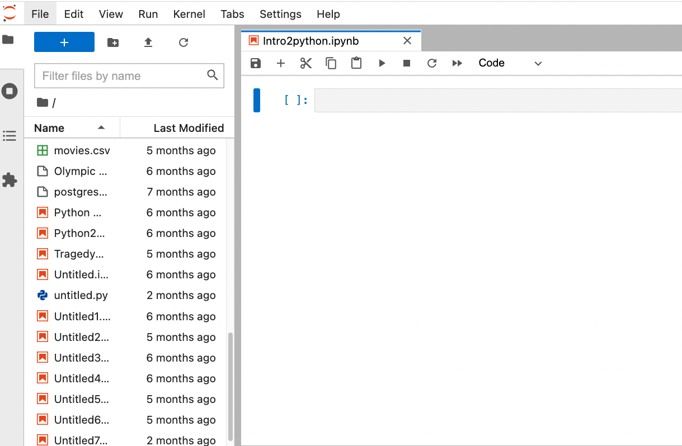
Jupyter Lab

Slide 14
Variables in Python
You can declare a variable and assign it a value in one statement
The print() function is useable with nearly all data types
x = 5
y = 'dollars'
print(x)
print(y)

Slide 15
Other types of assignment
a = b = c = d = "cold"
print(a)
print(b)
print(c)
print(d)
a = "Python is "
b = "fun!"
c = a + b
print(c)

